Slide 1


Slide 2


Code Reuse with .NET MAUI
Sam Basu | @samidip
Developer Advocate | Progress Telerik

Slide 3
Key Takeaways …
Easy to move to .NET MAUI
Blazor is beautiful with .NET MAUI
Modernize apps with code sharing

Slide 4

Feel the promise ..

Slide 5


Slide 6
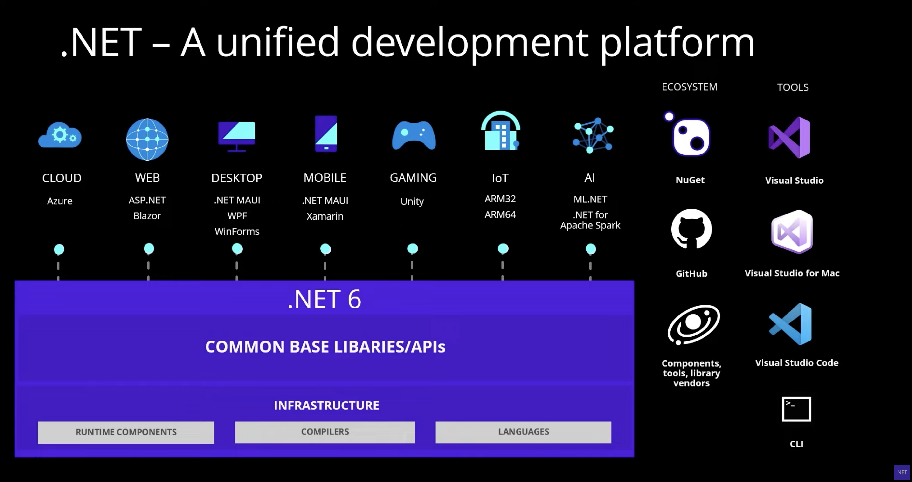

Slide 7




.NET MAUI Benefits
.NET 6
True Cross-platform | For Mobile & Desktop
Native UI & Performance | .NET Builder
Single project system | Shared Resources
Easy Platform API access
Handler Architecture | Easy Customization
Blazor Integration | Expansive ecosystem
.NET MAUI
WinUI
Mac Catalyst
iOS
Android
macOS
iOS
github.com/dotnet/maui

Slide 8

Blazing a Trail ..

Slide 9


Blazor All Things

Slide 10











Blazor Hybrid:
+

Slide 11

Reusability is key ..

Slide 12


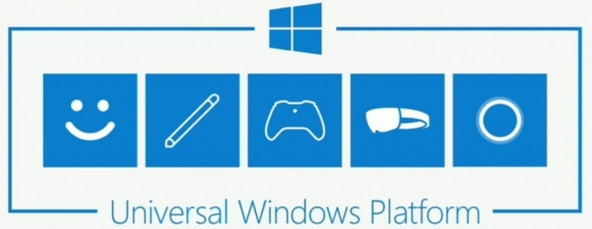
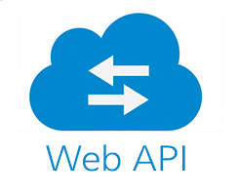

Migration & Modernization

Slide 13

Time to see code ..

Slide 14

Thanks for joining!
Ask your questions live on Twitter #dotNETConf
Let’s keep chatting | @samidip

